Slide 1
Module 13
GUI Event Handling
Objectives
Upon completion of this module, you
should be able to:
Define events and event handling
Write code to handle events that occurs in a GUI

Slide 2
Module 13
GUI Event Handling
Objectives
Upon completion of this module, you should be able to:
Describe the concept of adapter classes, including how and when to use them.
Determine the user action that originated the event from the event object details
Identify the appropriate interface for a variety of event types

Slide 3
Module 13
GUI Event Handling
Objectives
Upon completion of this module, you should be able to:
Create the appropriate event handler methods for a variety of event types
Understand the use of inner classes and anonymous classes in event handling

Slide 4
Module 13
GUI Event Handling
This module covers the event-based GUI user input mechanism.

Slide 5
Additional Resources
The following references provide additional details on the topics discussed in this module

Slide 6
Additional Resources
Java™ in 60 minutes a day
By Rich Raposa
Price:$36.50
Paperback: 800 pages
Publisher: Wiley; 1st edition (May 30, 2003)
Language: English
ISBN-10: 0471423149
ISBN-13: 978-0471423140
Product Dimensions: 9.2 x 7.4 x 1.7 inches
http://www.amazon.com

Slide 7
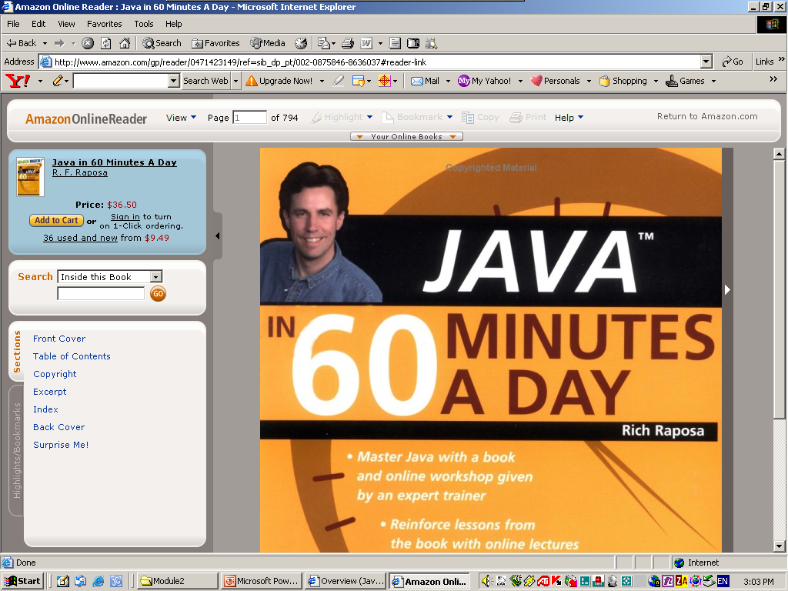
Additional Resources

Slide 8
Additional Resources
Java™ The UML Way
By Else Lervik, Vegard B. Havdal
Price:$65.00
Paperback: 732 pages
Publisher: John Wiley & Sons; English La edition (June 15, 2002)
Language: English
ISBN-10: 0470843861
ISBN-13: 978-0470843864
Product Dimensions: 9.2 x 7.6 x 1.7 inches
http://www.amazon.com

Slide 9
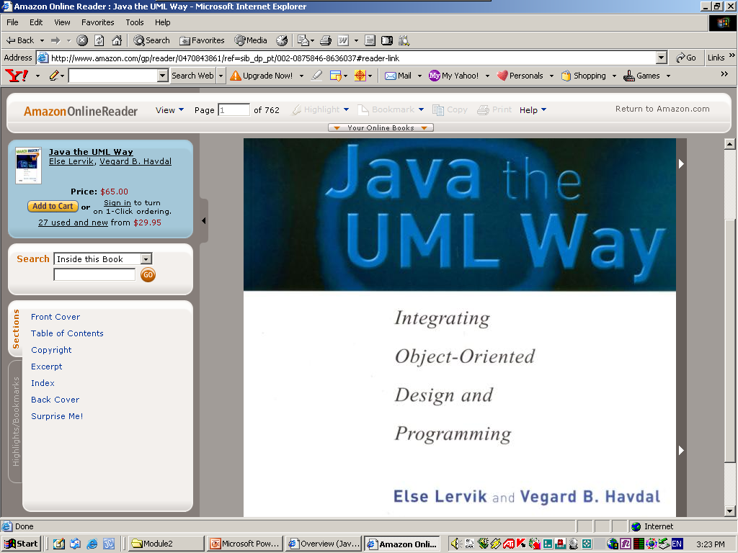
Additional Resources

Slide 10
Additional Resources
The Java™ Tutorials
http://java.sun.com/docs/books/tutorial/

Slide 11
Relevance
Discussion – The following questions are
relevant to the material presented in this
module:
What parts of a GUI are required to make it useful?
How does a graphical program handle a mouse click or any other type of user interaction?

Slide 12
What Is an Event?
When the user performs an action at the user interface level (clicks a mouse or presses a key), this causes an event to be issued.
Events are objects that describe what has happened. A number of different types of event classes exist to describe different categories of user action.

Slide 13
Event Sources
An event source is the generator of an event. For example, a mouse click on a Button component generates an ActionEvent with the button as the source.
The ActionEvent instance is an object that contains information about the events that just took place. It contains:
  getActionCommand() – Returns the command name associated with the action
  getModifiers() – Returns any modifiers held during the action

Slide 14
Event Handlers
An event handler is a method that receives an event object, deciphers it and processes the user’s interaction.

Slide 15
Java 2 SDK Event Model
This section describes the delegation event model.

Slide 16
Delegation Model
The delegation event model came into existence with JDK 1.1.
With this model, events are sent to the component from which the event originated, but it is up to each component to propagate the event to one or more registered classes called listener.
Listeners contain event handlers that receive and process the event. In this way, the event handler can be in an object separate from the component.
Listeners are classes that implement the EvenListener interface.

Slide 17
Delegation Model
Events are objects that are reported only to registered listeners.
Every event has a corresponding listener interface that mandates which methods must be defined in a class suited to receiving that type of event.
The class that implements the interface defines those methods, and can be registered as a listener.
Event from components that have no registered listeners are not propaged.

Slide 18
Delegation Model
Let’s see the following TestButton program and the ButtonHandler class that is the handler class to which the event is delegated.

Slide 19
import java.awt.*;
public class TestButton {
private Frame f;
private Button pressme;
private Button saveme;
private Button cancel;
private Panel p1;
private Panel p2;
private Panel p3;

Slide 20
public TestButton(){
f = new Frame("Test");
pressme = new Button("Press Me!");
saveme = new Button("Save Me!");
cancel = new Button("Cancel");
saveme.setActionCommand("Save Button Pressed");
pressme.setActionCommand("Press me Button Pressed");
cancel.setActionCommand("Cancel Button Pressed");
}

Slide 21
public void launchFrame() {
pressme.addActionListener( new ButtonHandler() );
saveme.addActionListener( new ButtonHandler() );
cancel.addActionListener( new ButtonHandler() );
p1 = new Panel();
p2 = new Panel();
p3 = new Panel();
p1.add(saveme, BorderLayout.CENTER);
f.add(p1, BorderLayout.NORTH);
p2.add(pressme, BorderLayout.CENTER);
f.add(p2, BorderLayout.CENTER);
p3.add(cancel, BorderLayout.CENTER);
f.add(p3, BorderLayout.SOUTH);
f.pack();
f.setBackground(Color.blue);
f.setVisible(true);
}

Slide 22
public static void main(String [] args) {
TestButton guiWindow = new TestButton();
guiWindow.launchFrame();
}
}

Slide 23
import java.awt.event.*;
public class ButtonHandler implements ActionListener {
public void actionPerformed( ActionEvent e ) {
System.out.println("Action ocurred");
System.out.println("Button's command is: " +
e.getActionCommand() );
}
}

Slide 24
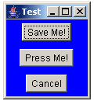
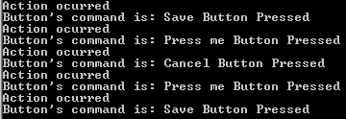
The Output Of The TestButton
Program

Slide 25
Delegation Event Model
This example has the following characteristics
  The Button class has an
  addActionListener(ActionListener act) method.
  The ActionListener interface define a single method, actionPerformed, which receives an ActionEvent.

Slide 26
Delegation Event Model
  Once created, a Button object can have an object registered as a listener for ActionEvents through the addActionListener() method. The registered listener is instantiated from a class that implements the ActionListener interface

Slide 27
Delegation Event Model
  The method getActionCommand() of the ActionEvent class returns the command name associated with this action.

Slide 28
Delegation Event Model
Note – There are other ways to determine why an event has been received. In particular, the method getSource() documented in the java.util.EventObject base class, is often useful because it allows you to obtain the reference to the object that actually sent the event.

Slide 29
Delegation Event Model
Event are not accidentally handled. The objects that want to listen to particular events on a particular GUI component register themselves with that component.
When an event occurs, only the objects that were registered received a message that the event occurred.
The delegation model is good for the distribution of work among classes.

Slide 30
Event Categories
The general mechanism for receiving events from components has been described in the context of a single type of event. Many of the event classes reside in the java.awt.event package, but others exist elsewhere in the API.

Slide 31
Event Categories
For each category of events, there is an interface that has to be implemented by the class of objects that wants to receive the events.
That interface demands that one or more methods be defined as well. Those methods are called when particular events arise.

Slide 32
Method Categories and Interfaces
Category | Interface Name | Methods
Action | ActionListener | actionPerformed(ActionEvent)
Item | ItemListener | itemStateChanged(ItemEvent)
Mouse | MouseListener | mousePressed(MouseEvent) mouseReleased(MouseEvent) mouseEntered(MouseEvent) mouseExited(MouseEvent) mouseClicked(MouseEvent)

Slide 33
Method Categories and Interfaces
Category | Interface Name | Methods
Mouse Motion | MouseMotionListener | mouseDragged(MouseEvent) mouseMoved(MouseEvent)
Key | KeyListener | keyPressed(KeyEvent) keyReleased(KeyEvent) keyTyped(KeyEvent)
Focus | FocusListener | focusGained(FocusEvent) focusLost(FocusEvent)

Slide 34
Method Categories and Interfaces
Category | Interface Name | Methods
Adjustment | FocusListener | adjustmentValueChanged(AdjustmentEvent)
Component | ComponentListener | componentMoved(ComponentEvent) componentHidden(ComponentEvent) componentResized(ComponentEvent) componentShown(ComponentEvent)
Container | ContainerListener | componentAdded(ContainerEvent) componentRemoved(ContainerEvent)

Slide 35
Method Categories and Interfaces
Category | Interface Name | Methods
Text | TextListener | textValueChanged(TextEvent)
Window | WindowListener | windowClosing(WindowEvent) windowOpened(WindowEvent) windowIconified(WindowEvent) windowDeiconified(WindowEvent) windowClosed(WindowEvent) windowActivated(WindowEvent) windowDeativated(WindowEvent)

Slide 36
Complex Example
This section examines a more complex Java code software example. It tracks the movement of the mouse when the mouse button is pressed ( mouse dragging). It also detects mouse movement even when the buttons are not pressed ( mouse moving).

Slide 37
Complex Example
The events caused by moving the mouse with or without a button pressed can be picked up by objects of a class that implements the MouseMotionListener interface.
This interface requires two methods, mouseDragged() and mouseMoved(). Even if you are interested only in the drag movement, you must provide both methods. However, the body of the mouseMoved() method can be empty.

Slide 38
Complex Example
To pick up other mouse events, including mouse clicking, you must implement the MouseListener interface. This interface includes several events including mouseEntered, mouseExited, mousePressed, mouseReleased, and mouseClicked.

Slide 39
Complex Example
When mouse or keyboard events occur, information about the position of the mouse and the key that was pressed is available in the event that it generated. In the first example on event hadling, there was a separate class named ButtonHandler that handled events. In the following example, events are handled within the class named TwoListener.

Slide 40
import java.awt.*;
import java.awt.event.*;
public class TwoListener implements MouseMotionListener, MouseListener{
private Frame f;
private TextField tf;
public TwoListener() {
f = new Frame("Two listener example");
tf = new TextField(30);
}

Slide 41
public void launchFrame() {
Label label = new Label("Click and drag the mouse");
// Add components to the frame
f.add(label, BorderLayout.NORTH);
f.add(tf, BorderLayout.SOUTH);
// Add this object as a listener
f.addMouseMotionListener(this);
f.addMouseListener(this);
// Size the frame and make it visible
f;setSize(300,200);
f.setVisible(true);
}

Slide 42
// These are MouseMotionListener events
public void mouseDragged(MouseEvent e)
{
String s = "Mouse dragging: x = " + e.getX() +
" Y = " + + e.getY();
tf.setText(s);
}
public void mouseExited(MouseEvent e ) {
String s = "The mouse has left the building";
tf.setText(s);
}

Slide 43
// Unused MouseMotionListener method.
//All methods of a listener must be present in the
//class even if they are not used.
public void mouseMoved( MouseEvent e) {}
// Unused MouseListener methods.
public void mousePressed(MouseEvent e) {}
public void mouseClicked(MouseEvent e) {}
public void mouseReleased(MouseEvent e) {}
public void mouseEntered(MouseEvent e) {}

Slide 44
public static void main(String [] args ) {
TwoListener two = new TwoListener();
two.launchFrame();
}
}

Slide 45
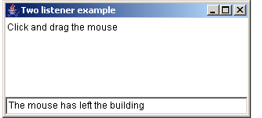
Output of the TwoListener Program

Slide 46
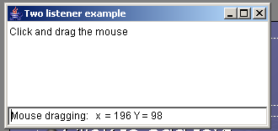
Output of the TwoListener Program

Slide 47
GUI Componentes and event Handling
Ahora que UD. puede crear sus propios programas GUI, probablemente este ansioso de iniciar este capitulo, especialmente porque sus programas GUI no tienen ninguna funcionalidad que los hagan verse bien.
Discutiremos el modelo de delegación, la arquitectura detrás del manejo de eventos en Java. Luego veremos varios componentes de del API de AWT y Swing, discutiremos como crearlos y como manejar sus eventos

Slide 48
The Delegation Model
Los eventos son excitados y manejados usando un diseño conocido como modelo de delegación.
Con el modelo de delegación, una fuente genera un evento y una clase escucha maneja los eventos de los componentes, creando un acercamiento orientado a objetos.

Slide 49
The Delegation Model
Existen tres roles relevantes en el modelo de delegación
  The source of the event. En la programación GUI el componente es fuente de un evento. Los Eventos son objetos Java que son instanciados por el componente y pasados como argumentos de cualquier escucha.

Slide 50
The Delegation Model
  An Event listener. Un escucha de un evento se registra así mismo con la fuente del evento. Cuando un evento ocurre, la fuente del evento invoca un método en el escucha.
  An interface. La interface contiene los métodos que los escuchas deben implementar y que la fuente del evento invoca cuando el evento ocurre.

Slide 51
The Delegation Model
Por ejemplo, cuando un usuario hace “clic” sobre un java.awt.Button, el Button genera un java.awt.ActionEvent. El Button invoca al método actionPerformed() en cada escucha registrado del Button, pasándole un objeto ActionEvent. El método actionPerformed() esta definido en la interface java.awt.event.ActionListener, el cual el escucha tiene que implementar.

Slide 52
The Delegation Model
En este escenario:
  El Button es la fuente del evento,
  La interface es ActionListener y
  El escucha es cualquier clase que implementa ActionListener y se registra a si mismo con un Button.

Slide 53
The Event Listener Interfaces
La insterface escucha de eventos contiene los métodos que las fuentes de eventos invocan en los escuchas. Y esta provee los medios de comunicación entre las fuentes de eventos y los escuchas del evento.
Cada tipo de evento tiene su correspondiente interface de escucha.

Slide 54
The Event Listener Interfaces
Java usa una convención estándar de denominación de las clases de los eventos y las interfaces de escuchas:
  El nombre de las clases de eventos usa la convención: <Name>Event y
  la correspondiente interface escucha usa la convención <Name>Listener.
Por ejemplo:
  una clase ActionEvent esta asociado con un método de la interface ActionListener, y
  la clase WindowEvent se asocia con siete métodos de la interface WindowListener.

Slide 55
The Event Listener Interfaces
Un evento de la interface de escuchas extiende la interface java.util.EventListener.
La interface EventListener no contiene ningún método; pero es usada para etiquetar una interface de un escucha de eventos para usarla con el modelo de delegación de manejo de eventos.

Slide 56
The Event Listener Interfaces
Por ejemplo, la interface ActionListener es definida como:
package java.util.event;
public interface ActionListener extends
java.util.EventListener
{
public void actionPerformed(ActionEvent e );
}

Slide 57
The Event Listener Interfaces
La interface ActionListener extiende a EventListener y está en el paquete java.awt.event, el cual es el paquete en donde están definidas todas las clases de eventos de AWT y las interfaces de escuchas.
El paquete javax.swing.event contiene las clases de eventos y de las interfaces únicas de Swing.

Slide 58
The Event Listener Interfaces
Los componentes AWT sólo generan eventos AWT mientras que los componentes Swing generan a ambos eventos AWT y Swing.
Por ejemplo, un JButton es la fuente de java.awt.event.ActionEvent (una clase de eventos AWT) y javax.swing.event.ChangeEvent (una clase de eventos Swing).

Slide 59
The Event Listener Interfaces
La interface ActionListener contiene un método, y el parámetro es un ActionEvent.
Cuando una acción de un evento ocurre, la fuente del evento instancia un objeto ActionEvent e invoca actionPerformed() a todos los escuchas, pasando un objeto ActionEvent.

Slide 60
The Event Listener Interfaces
Una interface de escuchas de eventos puede contener cualquier cantidad de métodos.
Los métodos son usados para determinar que causa el evento.
Con ActionEvent existe sólo un método actionPerformed() el cual simplemente es un medio para avisar que una acción ha ocurrido.
Por ejemplo, con los botones esto significa que el botón ha sido oprimido.

Slide 61
The Event Listener Interfaces
La interface WindowListener tiene siete métodos y el método que el evento fuente invoca depende de que causa el WindowEvent.
La interface WindowListener es definida como:

Slide 62
The Event Listener Interfaces
package java.awt.event;
public interface WindowListener extends
java.util.EvenListener
{
public void windowOpened( WindowEvent e);
public void windowClosing(WindowEvent e);
public void windlowClosed(WindowEvent e);
public void windowIconified(WindowEvent e);
public void windowDeiconified(WindowEvent e);
public void windowActivated(WindowEVent e);
public void windowDeactivated(WindowEvent e);
}

Slide 63
The Event Listener Interfaces
Por ejemplo, cuando un usuario selecciona X para cerrar una ventana, la ventana instancia un nuevo WindowEvent e invoca al método windowClosing() en todos los escuchas registrados.
Similarmente, la minimización de una ventana causa que Iconified() sea invocado, al restaurar la ventana causa que se invoque windowDeiconified(), y así sucesivamente. La ventana invoca el método apropiado en el escucha, dependiendo de que ha causado el WindowEvent.

Slide 64
The Event Listener Interfaces
Cada uno de los tipos de eventos tiene una clase de evento y una interface de evento. Ellos comparten un nombre común, tal como ActionEvent y ActionListener,ItemEvent e ItemListener, y así sucesivamente.
Un escucha de un evento debe implementar su correspondiente interface evento.
Por ejemplo, si se desea escuchar un evento ItemEvent, se debe escribir una interface que implemente la interface ItemListener.

Slide 65
Creating an Event Listener
Si un escucha quiere escuchar un tipo particular de evento, entonces el escucha debe implementar la correspondiente interface del correspondiente escucha de evento.
Desde el punto de vista de la programación esto significa que se necesita escribir una clase que implemente la interface de escucha.
Si se desea un evento ActionEvent UD. necesita implementar un ActionListener.
Si UD. desea escuchar un evento WindowEvent, UD. debe escribir una clase que implemente a WindowListener.

Slide 66
Creating an Event Listener
La siguiente clase RandomColor es un ActionListener que en su constructor inicializa un campo para que apunte a un Contenedor cuyo color debe ser cambiado.
Al utilizar una referencia de tipo Container se le permite a la clase RandomColor cambiar el color no sólo de la ventana sino de cualquier Container.

Slide 67
Creating an Event Listener
import java.awt.*;
import java.awt.event.*;
public class RandomColor implements ActionListener
{
private Container container;
public RandomColor( Container c )
{
container = c;
}

Slide 68
Creating an Event Listener
public void actionPerformed( ActionEvent e )
{
System.out.println ( e + “ just occurred.”);
int red, green, blue;
red = ( int ) (Math.random() * 256 );
green = ( int ) (Math.random() * 256 );
blue = ( int ) (Math.random() * 256 );
Color color = new Color(red, green, blue );
container.setBackground(color);
}
}

Slide 69
Registering a Listener with an Event Source
Después de escribir una clase escucha, UD. debe registrarla con el componente que UD. desee que maneje el evento.
Si un componente genera un evento este componente tiene un método de la forma <Event_name>Listener().
Por ejemplo, un Button genera un ActionEvent y la clase Button contiene el siguiente método:
public void addActionListener( ActionListener e )
Similarmente , un Frame genera un WindowEvent y contiene el siguiente método:
public void addWindowListener( WindowListener w )

Slide 70
Registering a Listener with an Event Source
Los tipos de los parámetros de los dos métodos son de tipo interface.
Si se desea escuchar el ActionEvent de un Button, UD. necesita escribir una clase que implemente ActionListener, así UD. debe pasar una instancia al método addActionListener().

Slide 71
Registering a Listener with an Event Source
Si UD. desea escuchar un WindowEvent de un Frame, UD. necesita escribir una clase que implemente WindowListener, así le puede pasar una instancia al método addWindowListener().

Slide 72
Registering a Listener with an Event Source
La siguiente clase EventDemo crea un botón y registra una instancia de la clase RandomColor como escucha de un botón:

Slide 73
Registering a Listener with an Event Source
import java.awt.*;
public class EventDemo extends Frame
{
private Button go;
public EventDemo(String title )
{
super(title);
go = new Button(“Go”);
// Instantiate a listener object
RandomColor changer = new RandomColor(this);

Slide 74
Registering a Listener with an Event Source
// Register the listener with the button
go.addActionListener(changer);
//Add the button to the frame.
this.setLayout( new FlowLayout() );
this.add(go);
}

Slide 75
Registering a Listener with an Event Source
public static void main( String[] args )
{
Frame f = new EventDemo(“Click the
button…”);
f.setSize(300,300);
f.setVisible(true);
}
}

Slide 76
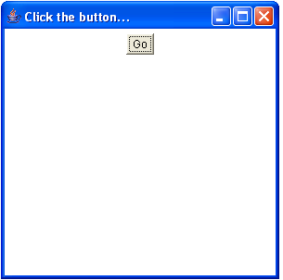

Slide 77
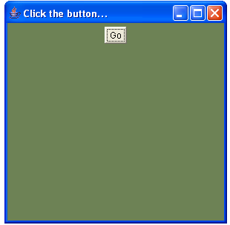

Slide 78
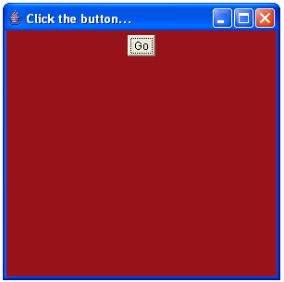

Slide 79
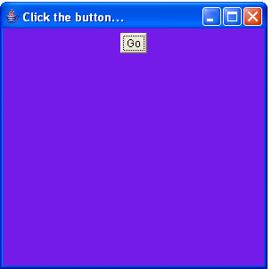

Slide 80
